Slide 1
Pan-genomic analysis of novel genomes from the manganese-oxidizing genus Candidatus Manganitrophus
Friday, November 5th, 2021
Ben Joris
Gloor Lab
Notes:
Good afternoon everyone, I’m Ben from the Gloor lab and Ill be discussing my recent work investigating two novel genomes belonging to the recently-described manganese-oxidizing genus Candidatus Manganitrophus.

Slide 2
Introduction – Pangenomics
Pan-genome refers to the total gene content from all strains within a clade
Core genome – genes that persist in all strains
Accessory genome – genes that are present in some or one strain, related to bacterial adaptation to an environment
Notes:
To begin, I will describe the field of methods used to investigated these genomes, which is termed Pangenomics. A pan-genome refers to the total gene content from all strains in a clade. It is used to assess what the what genes are involved in adaptive evolution. The core genome are the gene clusters that have orthologues in all strains being analyzed. These genes are not likely involved in the ability of the clade to adapt to the environment. On the other hand, the accessory genome are gene clusters found in some strains or only one strain and are more likely to be involved in the bacteria’s adaption to the environment.

Slide 3
Introduction – Candidatus Manganitrophus
Genus first described in 2020 (Yu and Leadbetter 2020)
Only contains a single member species, Candidatus Manganitrophus noduliformans
Authors demonstrated the ability of the species to oxidize manganese and fixate carbon through the reverse tricarboxylic acid cycle
Yu, H., & Leadbetter, J. R. (2020). Bacterial chemolithoautotrophy via manganese oxidation. Nature, 583(7816), 453–458.
Notes:
The genus that our novel genomes belong to is Candidatus Manganitrophus, which was first described last year. Currently, the isolate described in the paper, Candidatus Manganitrophus noduliformans, is the only member of the genus. In the publication, the authors demonstrated the ability of this strain to oxidize manganese and fixate carbon through the reverse tricarboxylic acid cycle. This oxidation of manganese is sufficient to generate slow exponential growth in the absence of other substrates in the culture.

Slide 4
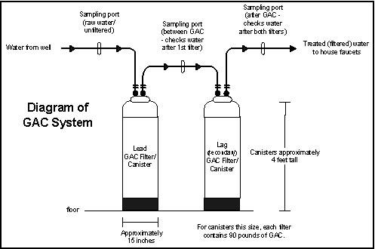
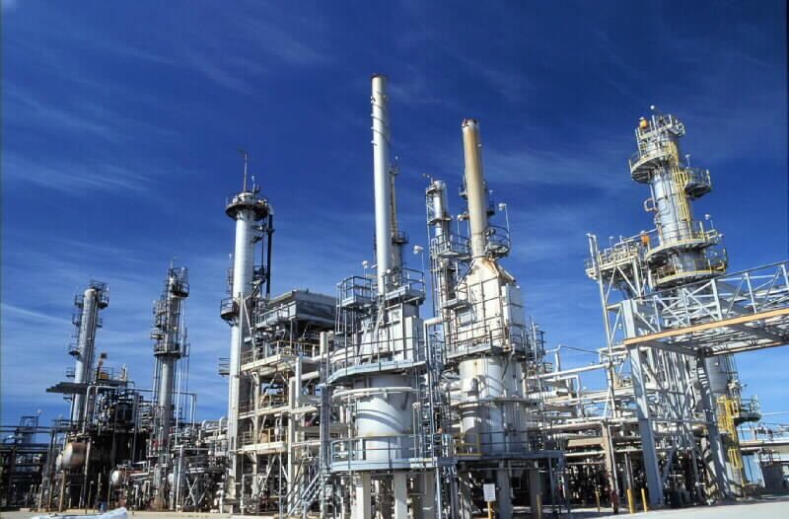
Introduction – Sample Characteristics
Metal and hydrocarbon-contaminated wastewater is filtered through GAC system
Biofilms form over time on the filters, eventually forcing replacement
Image: https://www.health.state.mn.us/communities/environment/hazardous/topics/gac.html#types
Image: https://www.flickr.com/photos/suncorenergy/4777170633
Notes:
The two genomes of Candidatus Manganitrophus that we analyzed were derived from an assembled metagenome of a granular activated charcoal filter, or GAC filter. At oil refineries, such as Suncor Energy’s Sarnia plant where our samples were sourced, metal and hydrocarbon contaminated wastewater is filtered through these GAC systems to filter the toxic impurities out. These GAC filters are very effective, however, they eventually need to be replaced because bacterial biofilms form over time on them to the point where they can no longer effectively filter the water. It is believed that the bacteria that colonize these filters play a major role in the removal of the toxic compounds from the wastewater. The biofilms growing on the charcoal were lysed and their DNA was sequenced on a nanopore minion sequencer.

Slide 5
Methods – Assembly of CM_gac_1
Genome was circularized through standard metagenomic assembly with metaFlye utilizing Oxford Nanopore sequencing reads
CM_gac_1
Assembly with metaFlye
Nanopore reads
Assembled DNA sequences
Notes:
One of the benefits of using a long-read sequencing technology, such as the Oxford Nanopore Minion, is that your input DNA is directly sequenced at whatever length you isolate it. The long fragments of DNA in the tens to hundreds of kilobases are very effective for metagenomic assembly as the create scaffolds that span repetitive regions in the genome that illumina-based assemblies often break at.
For the first isolate, which I will refer to as CM gac 1, it was readily assembled from the initial metagenomic assembly with the algorithm metaFlye. This chromosome was identified as being part of the genus Candidatus Manganitrophus through taxonomic assignment of all contigs in the assembly with the program CATBAT.

Slide 6
Methods – Assembly of CM_gac_1 plasmid
The conjugative plasmid of CM_gac_1 plasmid could be identified from the metagenomic assembly due to share taxonomic assignment
Contains pHMM hits for 3 classes of conjugative proteins
CM_gac_1
Assembly with metaFlye
Nanopore reads
Two circularized contigs with a shared taxonomy
Notes:
In addition to a circularized chromosome, we also identified a conjugative plasmid that was circularized. This contig shared the same CATBAT taxonomy as CM gac 1, suggesting they are derived from the same organism. The sequence contains profile hidden markov models for a relaxase, type four coupling proteins, and type 4 secretion system proteins.

Slide 7
Methods – Assembly of CM_gac_1 plasmid
~330kb plasmid aligns to published genome of Candidatus Manganitrophus noduliformans
Strain was not flagged as having a conjugative plasmid in the original paper
Closed sequences allow for analysis of full genomic context
Notes:
To further confirm that this identified circularized contig is indeed a plasmid of Candidatus Manganitrophus, we aligned it to the published genome of Candidatus Manganitrophus noduliformans. Several genetic fragments from the published genome aligned to the plasmid confirming our suspicion that it indeed belongs to CM GAC 1. In the original paper, the isolate was not flagged as containing a conjugative plasmid. Closed genetic assemblies allow for a complete understanding of the genomic context of sequences.

Slide 8
Methods – Assembly of CM_gac_2
Genome of the second Candidatus Manganitrophus could not be initially circularized by metaFlye
Assembly with metaFlye
Nanopore reads
Fragmented Candidatus Manganitrophus
Notes:
For the second strain, a simple metagenomic assembly did not yield a circularized Candidatus Manganitrophus genome. In the assembly, however, there were a number of uncircularized fragments with the same taxonomic assignment as we had seen for CM GAC 1.

Slide 9
Methods – Assembly of CM_gac_2
To produce a closed genome of CM_gac_2, reads from the second sample were mapped to the closed genome
Only strongly mapping reads were used for a “pseudo-isolate” assembly
Assemble with Flye
Reads with high
alignment score
Notes:
To generate a circularized genome of the second, we aligned the nanopore reads from the second GAC sample to the CM GAC 1 genome. The alignments were filtered to only retain reads with a very strong alignment score. This reduced set of sequencing reads was passed through the Flye assembler, designed for isolate assembly, and successful assembled the sequence of CM GAC 2. However, the plasmid was not able to assembled through this method.

Slide 10
Results – Summary
 | Candidatus Manganitrophus noduliformans | Candidatus Manganitrophus GAC 1 | Candidatus Manganitrophus GAC 2
Total Base Pairs | 5171380 | 4562547 | 4636677
Number of contigs (circular) | 22 (0) | 2 (2) | 11 (1)
% Completion | 98.58 | 95.40 | 96.58
% Contamination | 4.55 | 2.73 | 3.64
% GC | 56.41 | 56.13 | 56.10
Notes:
The two new sequences are roughly the same number of basepairs, however are roughly 500 kilobases smaller in size than the genome of Candidatus Manganitrophus noduliformans. The original genome was fragmented and it’s possible that it contained an additional plasmid that could not be recovered from the metagenome. All the genomes have strong completion and contamination metrics, suggesting high quality assemblies. They also all have nearly identical GC content, further cementing their similarities.

Slide 11
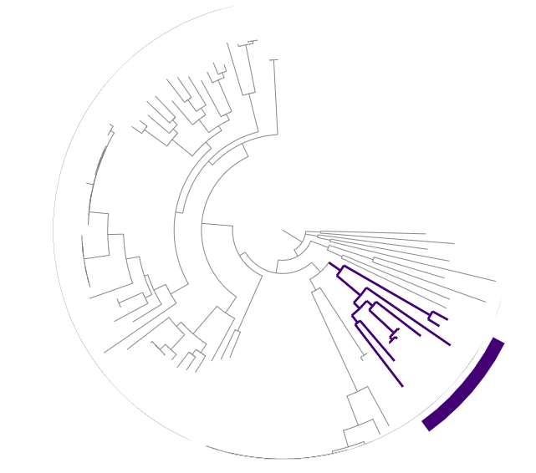
Results – Phylogeny of Novel Strains
Phylogeny based on unofficial class that Candidatus Manganitrophus from overall Nitrospirae phylogeny
Highlighted subclade was used for average nucleotide identity analysis
Notes:
To confirm the relation of the two novel genomes to Candidatus Manganitrophus noduliformans we placed them on the phylogenetic tree of the phylum Nitrospirae. The phylogenetic tree was generated by using alignments of bacterial single copy genes. All three genomes are very similar and cluster together on the tree. The genomes highlighted on the tree we used for average nucleotide identity to further assess similarities.

Slide 12
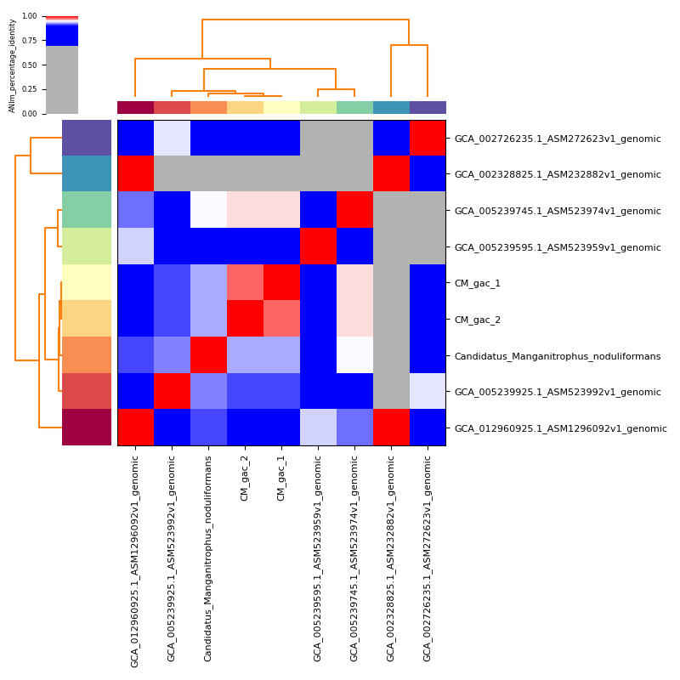
Results – ANI of subclade
Two novel genomes show the highest degree of identity to Candidatus Manganitrophus noduliformans
CMN – CM_gac_1: 93.3%
CMN – CM_gac_2: 93.3%
CM_gac_1 – CM_gac_2: 97.7%
Notes:
All three genomes show high degrees of sequence identities to one another. Candidatus Manganitrophus noduliformans had roughly 93% identity to the two novel strains and the two novel strains had nearly 98% identity to one another.

Slide 13
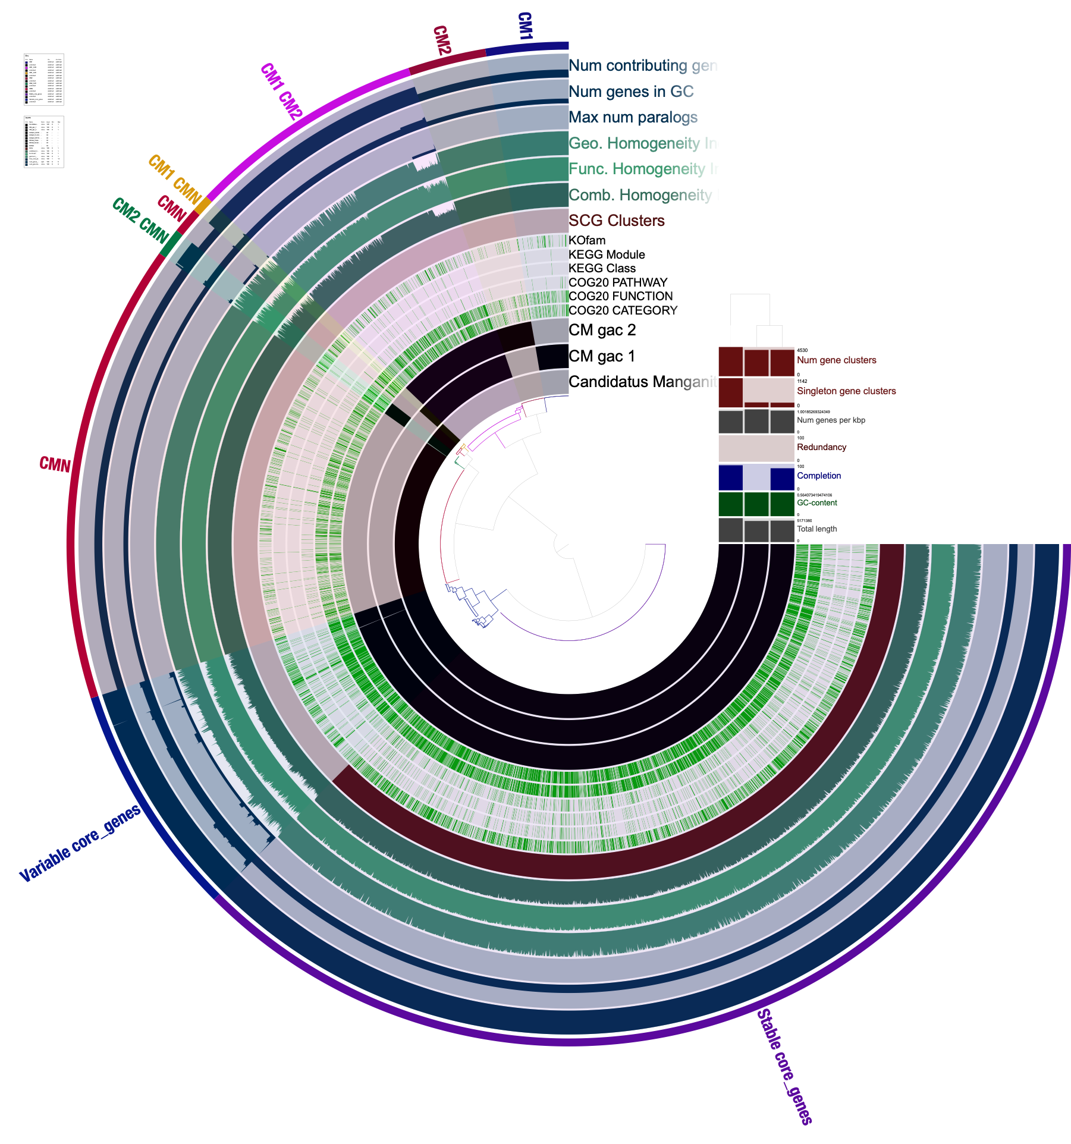
Results – Pangenome
Manganese oxidases are found in the core and variable core gene set, suggesting that the ability to oxidize manganese is preserved in the novel bacteria
The accessory genome, particularly the gene clusters that are private to a genome, have a higher density of genes that do not have annotated functions.
Notes:
Now that we had established that our two novel genomes are related to Candidatus Manganitrophus noduliformans on a genus level, if not closer, those three genomes will be used to establish the pangenome of the clade. The gene clusters featured in the bottom section of this cladogram are part of the core genome which is conserved amongst all the members. Orthologues are present in all genomes with some level of sequence variation. In the top half of the cladogram are the gene clusters the are part of the accessory genome that only are present in some or one of the genomes (indicated by the black bars). Genes related to manganese oxidation are present in the core and variable core genome, which suggests that the ability to oxidize manganese for energy found in Candidatus Manganitrophus noduliformans is conserved in the two novel genomes. Visually, you can see a lower density of green tick marks in the inner track have a lower density in the accessory genome demonstrating that more unannotated genes are found in the accessory genome.

Slide 14
Result – COG modules across pangenome
Notes:
For the categories function unknown and general function prediction only, the accessory genome has a higher proportion of its gene belonging to them, confirming the findings from the cladogram. In addition, Cell Wall biogenesis, Defense Mechanisms, Mobilome, and inorganic ion transport genes are also higher in proportion in the accessory genomes, whereas in the core genome things like core metabolism, protein and amino acid production, and ribosomal genes are enriched. The varying proportions of these COG modules in the accessory and core genomes are indicative of their role in adaptation to their environments.

Slide 15
Results – Additional Annotation
Cas1/Cas2/Cas3/Cas4/Cas5/Cas6/Cas7 present in CMN
All strains contain same UniRef50 annotations for manganese binding/transport genes
AromaDeg/CANT-HYD annotations are consistent between genomes
 | Candidatus Manganitrophus noduliformans | Candidatus Manganitrophus GAC 1 | Candidatus Manganitrophus GAC 2
Number of CRISPR arrays | 5 | 0 | 0
AromaDeg annotations | 12 | 13 | 13
CANT-HYD annotations | 37 | 35 | 32
Notes:
In addition to COGs and KEGG annotation, the genomes were annotated with pilerCR to predict crispr arrarys, and the AromaDeg and CANT HYD databases to predict hydrocarbon degradation genes. As was suggested by the COGs annotations, there are differences in defense mechanisms, reflected in the CRISPR system. 5 CRISPR arrays and uniref50 annotations for Cas1-7 genes whereas the novel genomes had no arrays or Cas genes detected. All the genomes shared the same transporters and binding genes in the UniRef annotations, which mirrors the manganese oxidase genes from the KEGG annotations. The hydrocarbon degradation genes are also consistent between the genomes.

Slide 16
Conclusion
Two new circularized genomes of recently discovered genus
A previously unidentified conjugative plasmid from Candidatus Manganitrophus
Pangenomic analysis suggest differences in defense mechanisms, cell wall biogenesis, mobilome, and ion transport
Manganese transport/binding and hydrocarbon degradation conserved
Notes:
So, in conclusion, we circularized two novel genomes of a recently discovered genus, and in addition, we identified a conjugative plasmid that previously unannotated in the published genome. From the pangenomic analysis, adaptation to the environment like involves genes involved in defense mechanisms, cell wall biogenesis, mobilome, and inorganic ion transport. In contrast, manganese metabolism and hydrocarbon are conserved in the genus.
In the near future, we are looking to complete additional genomes from the GAC filters to get a better idea of adaptive evolution in this genus.

Slide 17
Acknowledgements
Gloor Lab:
Dan Giguere
Henry Say
Advisory Committee:
Greg Gloor
David Edgell
Robert Hegele
Funding Sources:
Suncor Energy
Schulich School of Medicine

